Slide 1


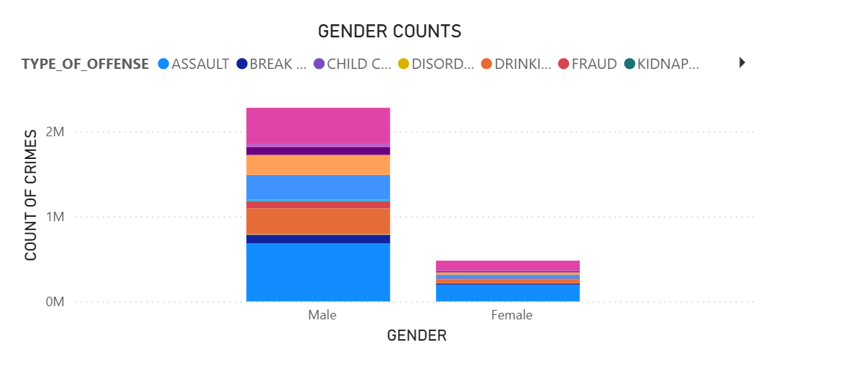
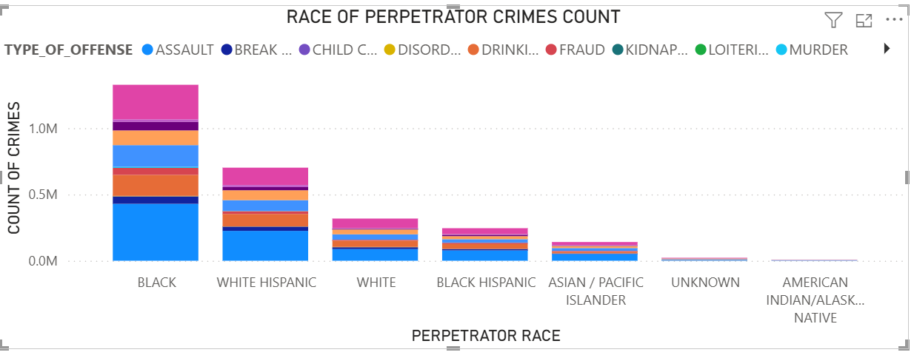
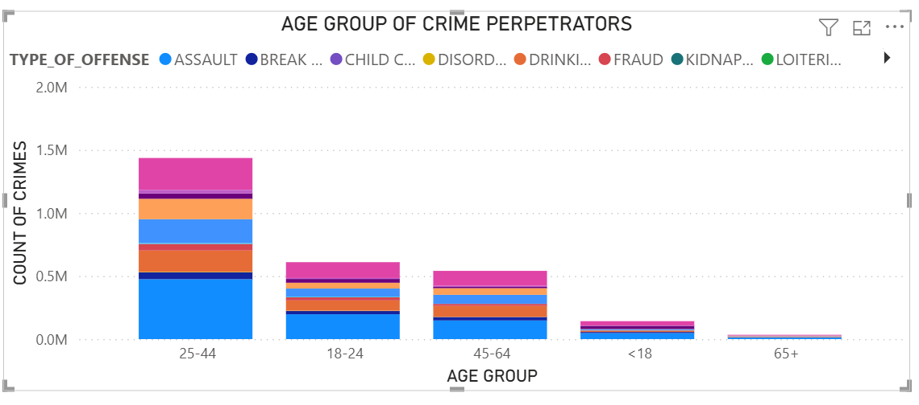
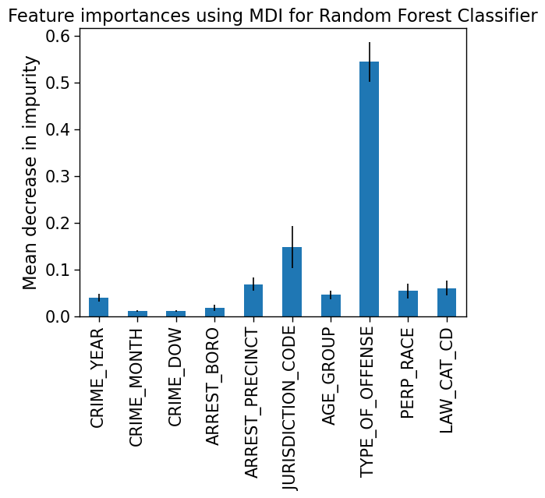
2024-2025 M.Sc. in Data Science and Analytics
APPLICATION OF DATA MINING TO THE ANALYSIS OF CRIME DATA
Vanessa Afolabi Supervisor: Dr. Mucahit Cevik
Objective: The goal is to perform a deep dive analysis into the historical crimes and arrests data taken from New York City and Toronto from 2014 to 2024, in order to answer questions related to the types of crimes that tend to take place in major metropolitans, where and when they usually occur within each city and to predict the persona and demographics of the criminals linked to different types of crimes.
Background: The occurrence of crime is an inevitable part of society. Different parts of society see varying rates of occurrence of different types of crimes at different points in time. By using data science to extract meaningful insights from historical crime data originating from busy metropolitans, one can learn a lot about the nature of different crimes, crime hotspots, criminal personas and when crimes tend to occur. These tools can ultimately be used by law enforcement to help mitigate criminal activity, solve crimes and discover trends thereby improving overall public safety and quality of life.
Results:
Methodology: Descriptive analytics tools such as exploratory data analysis and PowerBI were used to create advanced visualizations that highlighted criminal trends and patterns by interlaying input features such as the year, months and day of week of crimes, the race, age group and gender of criminals and the offense type, law category code, location, premises and jurisdictions of criminal activity. Predictive analytics was then used to build a classification model to predict the gender of criminals and hereby highlight which crime data features are most important when predicting the gender of a perpetrator.
Conclusions: In summary, the data shows that black and white hispanic males aged 25 to 44 commit the most crimes, with their crimes of choice usually being assault, drinking/drug offenses and theft. These crimes tend to occur outside and in apartments, commercial buildings and houses during the middle of the week from Wednesday to Friday, all throughout the year but mostly during spring (March and May), August and October. In addition, when crimes occur people take on average 27 days to report them.The results also show that when building a classification model to predict the sex of a perpetrator the most important features, in decreasing order are the type of offense, the location of the crime(precinct and jurisdiction) and the race of the perpetrator.

